Slide 1


Slide 2
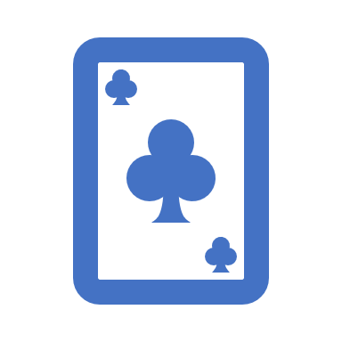
Playing Cards Detection and Identification
Ravindu Fernando
S/17/355

Slide 3
Why choose this project?.
Motivation : I am personally a big fan of tabletop card games like Omi, which is a very famous card game enjoyed by both young and old alike in Sri Lanka. However, players have ample opportunity to cheat in a game of Omi which can be frustrating to other players.
Goal : When given an image, identify and recognize all cards from a standard 52 card deck of playing cards, regardless of the background/orientation the photo was taken in. Program will keep track of the game of Omi for eight rounds and declare the winner at each round of the game and the overall winner.

Slide 4
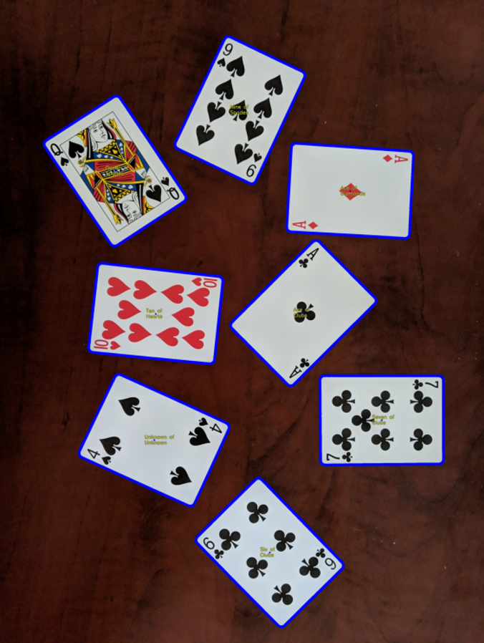
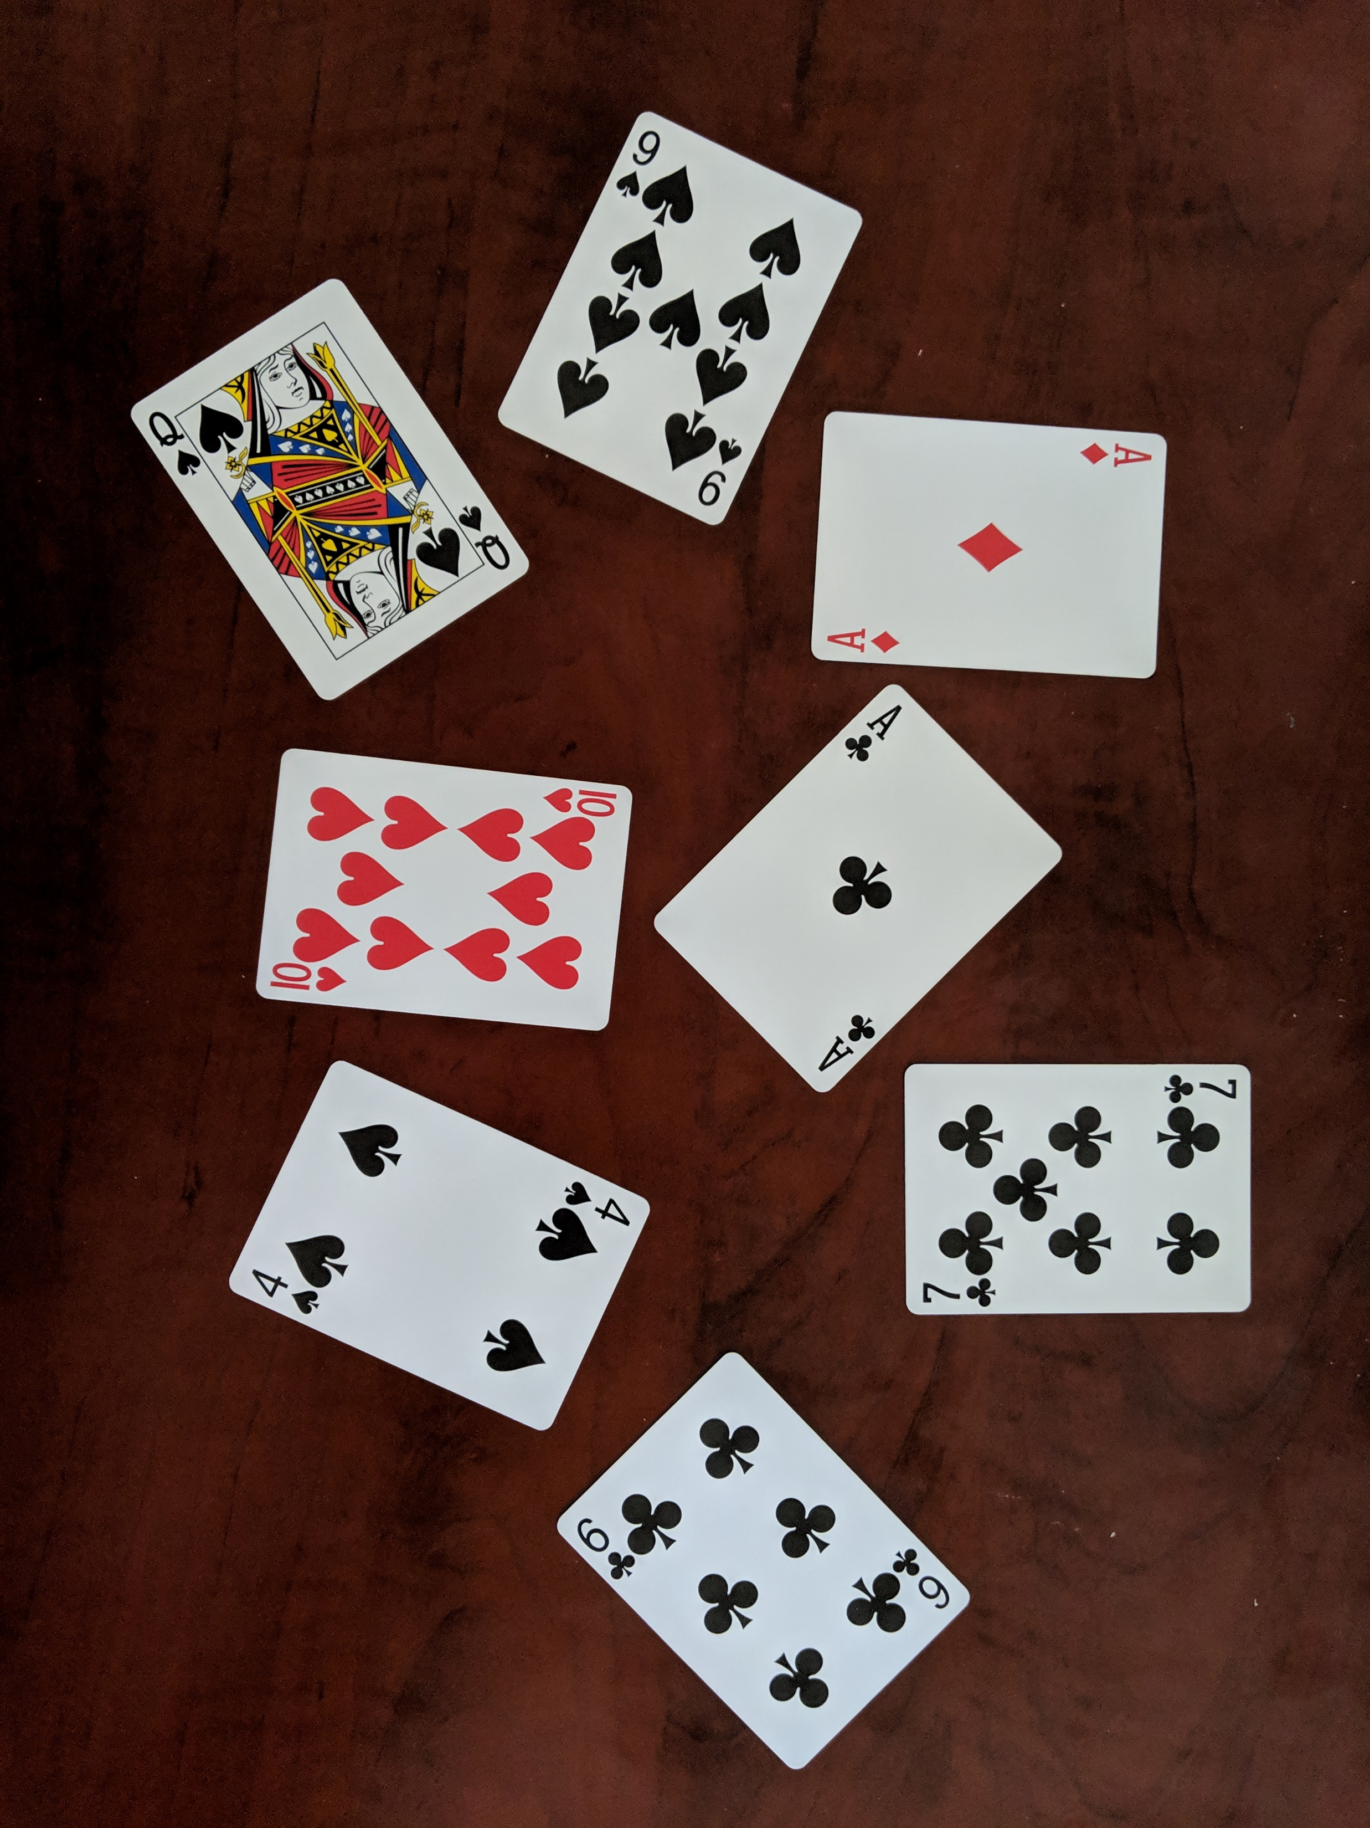
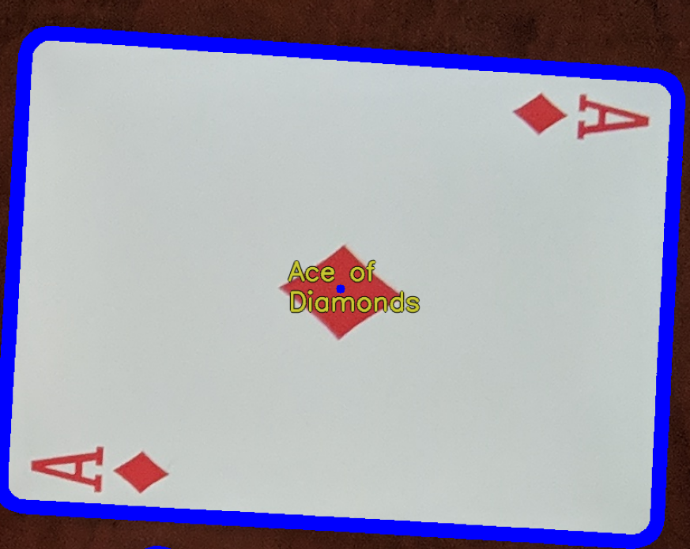
Immediate Result

Slide 5
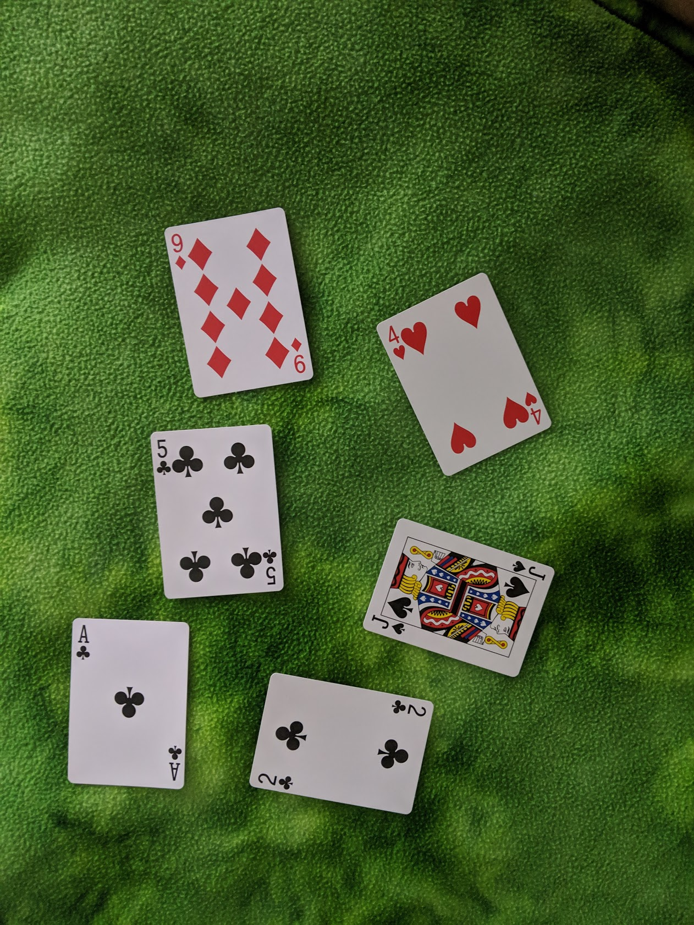
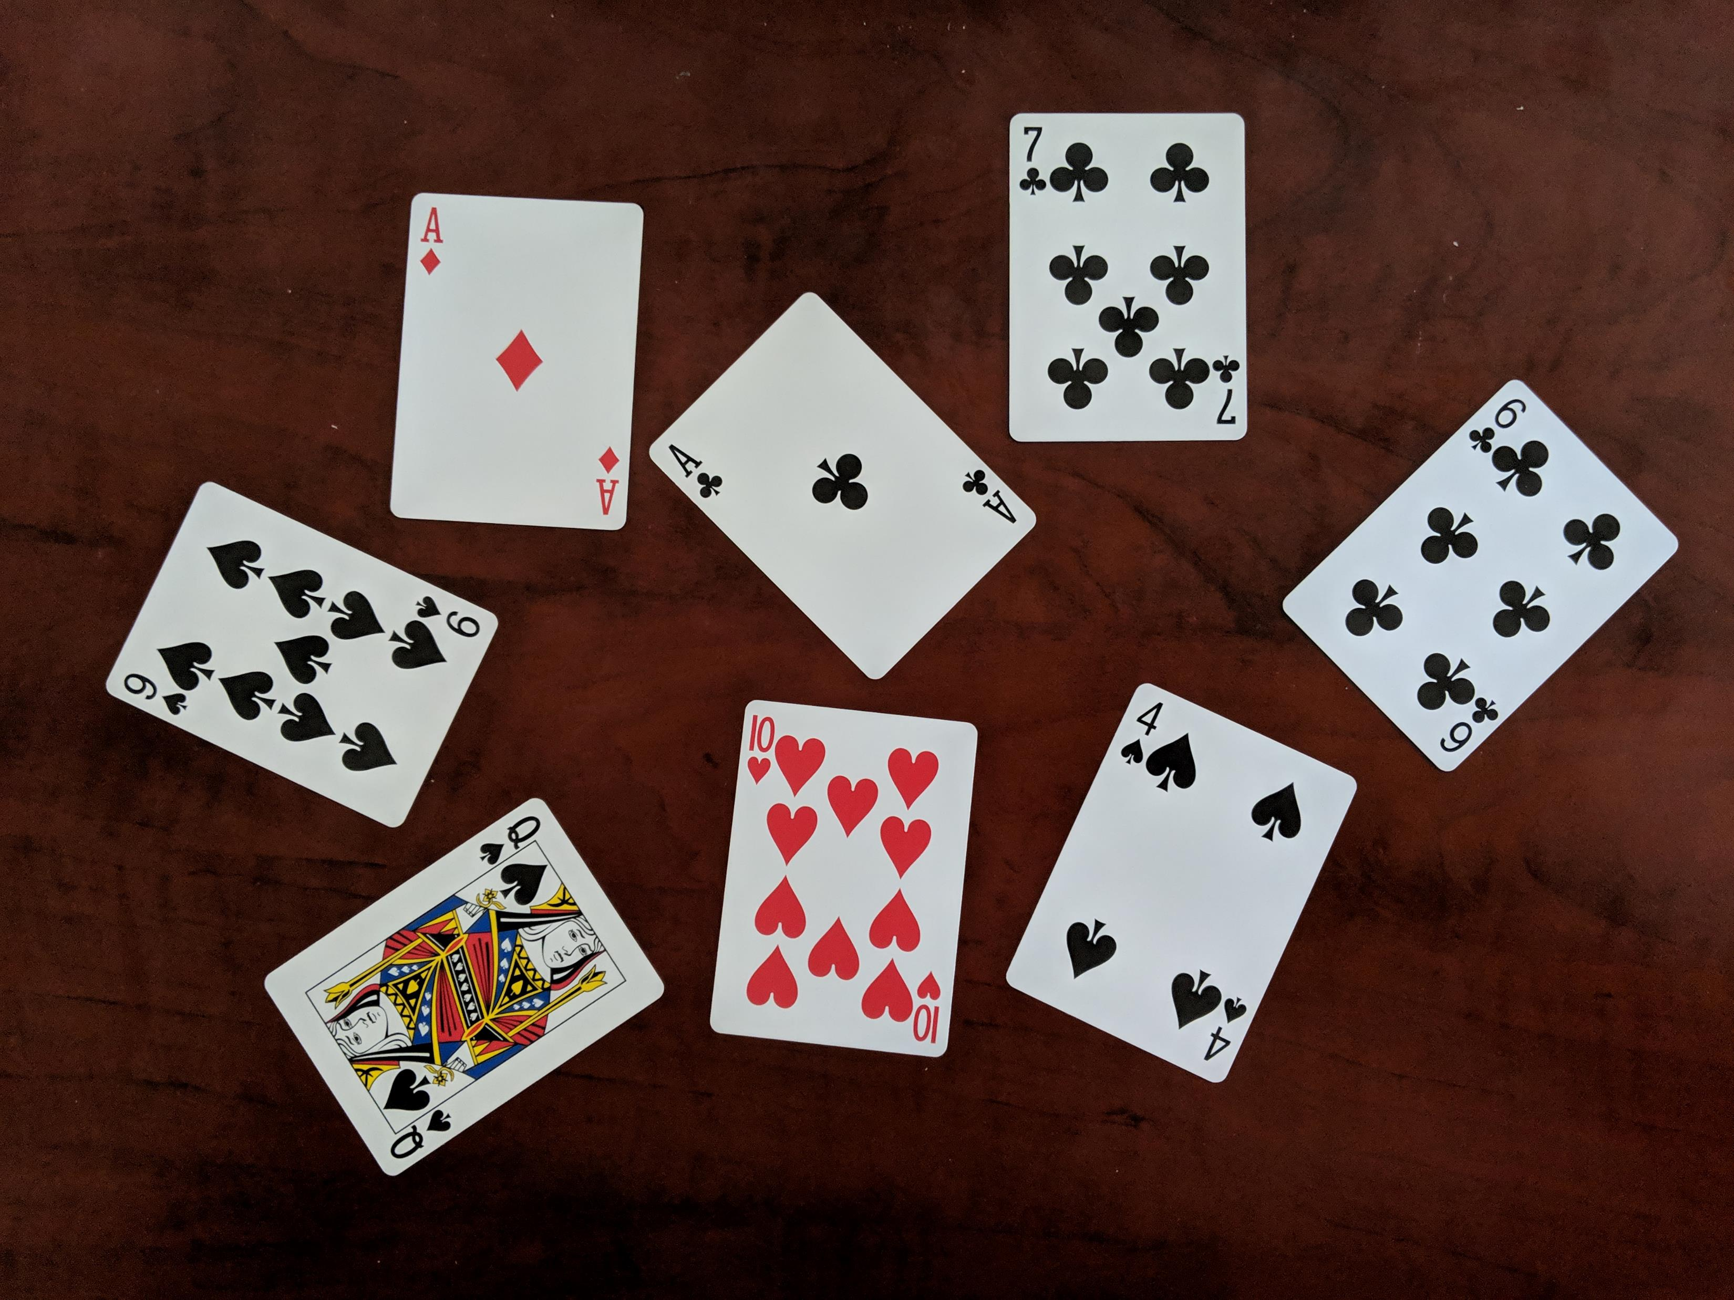
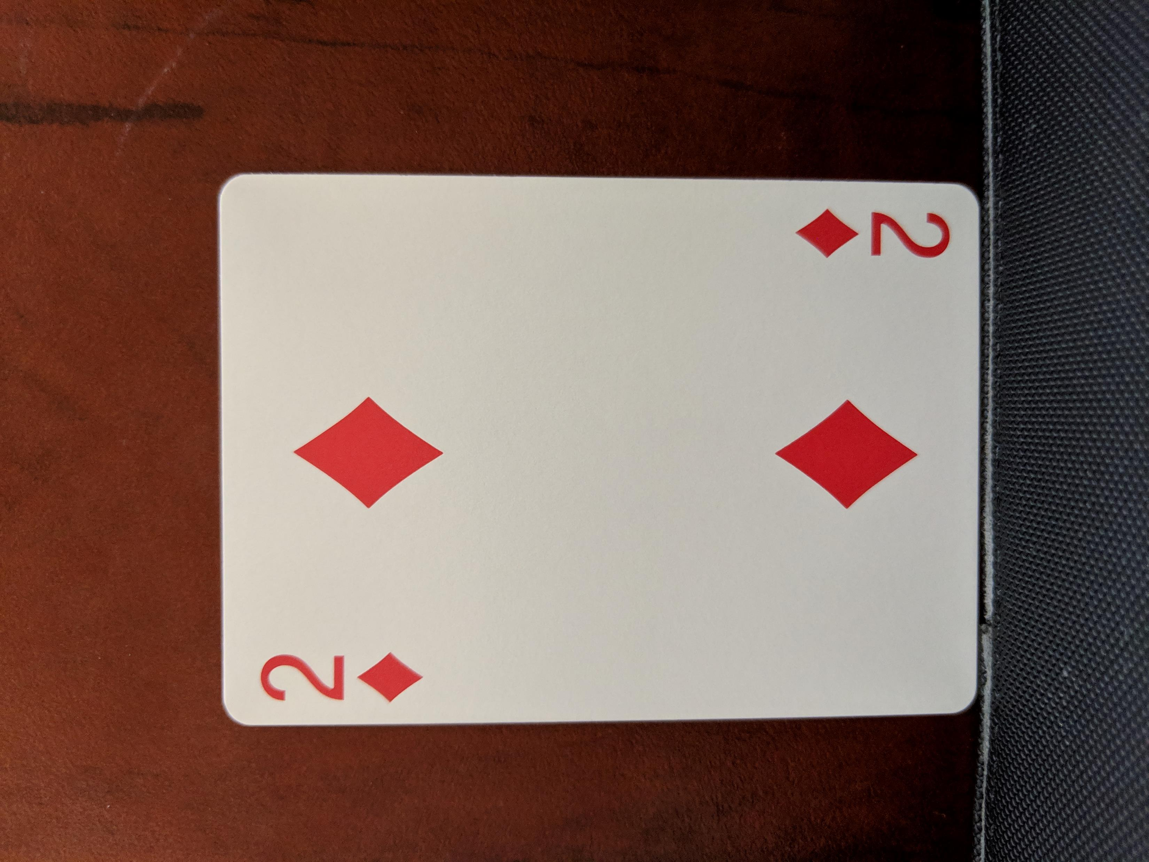
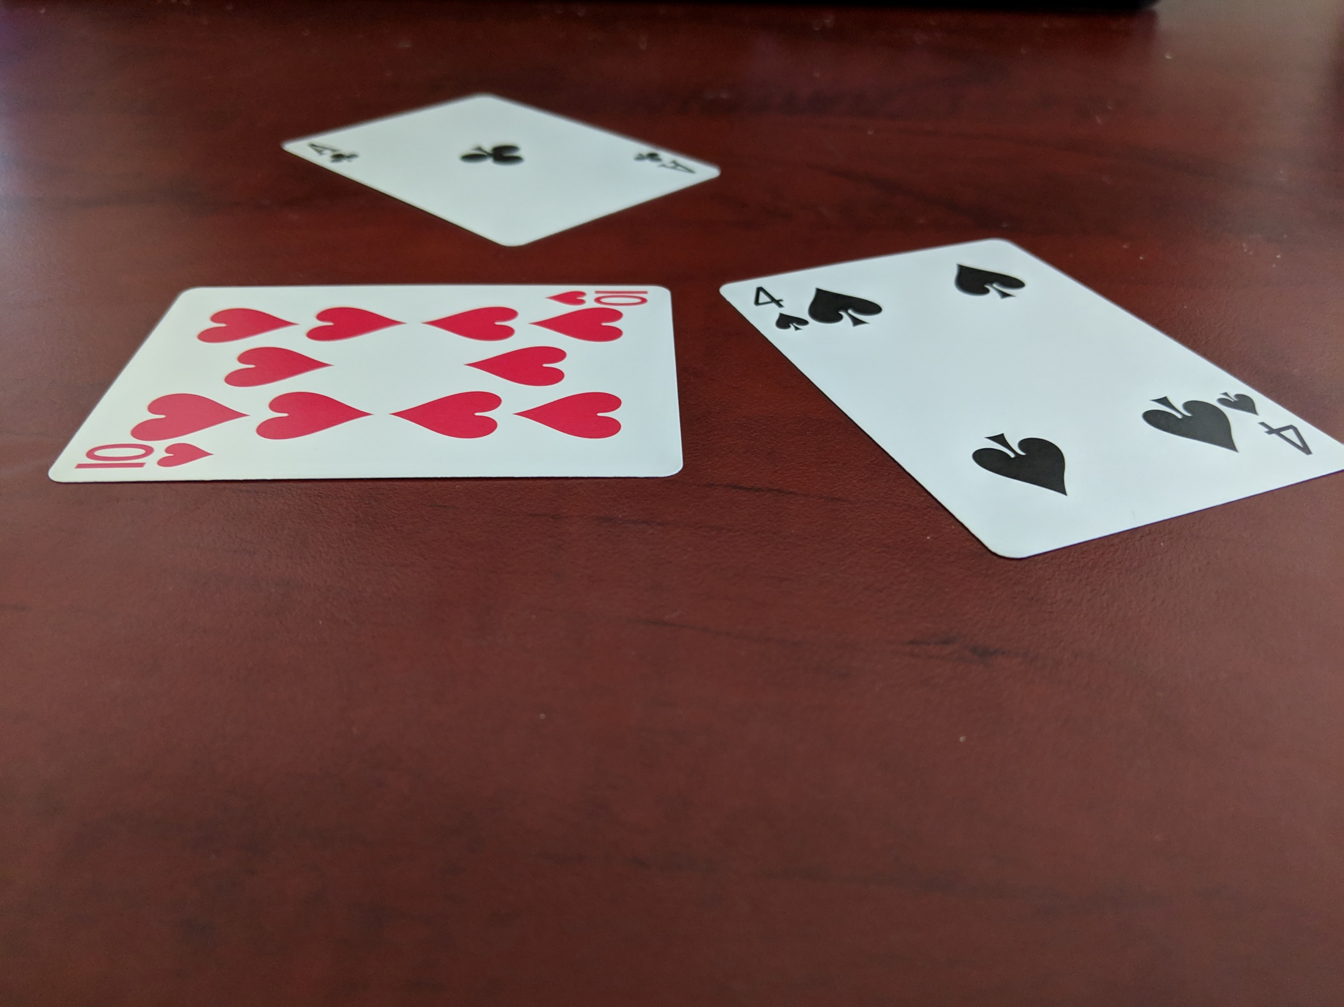
Sample Images
Luckily there was no trouble finding a good sample of photos to work with, I have taken photos a standard playing cards using my smartphone.

Slide 6
Approach and Considerations
Approach to the problem
Detect where all the cards in the image.
Crop and transform individual cards in preparation.
Identify the rank and suit of each card found in previous steps using template matching.
Additional Considerations
Identify cards in a variety of orientations and on a variety of backgrounds.

Slide 7
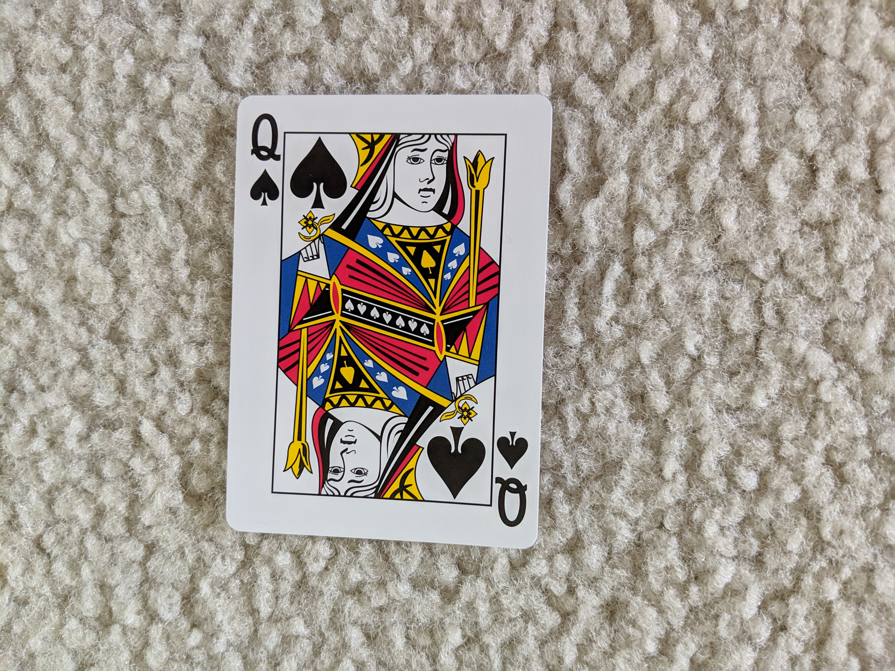
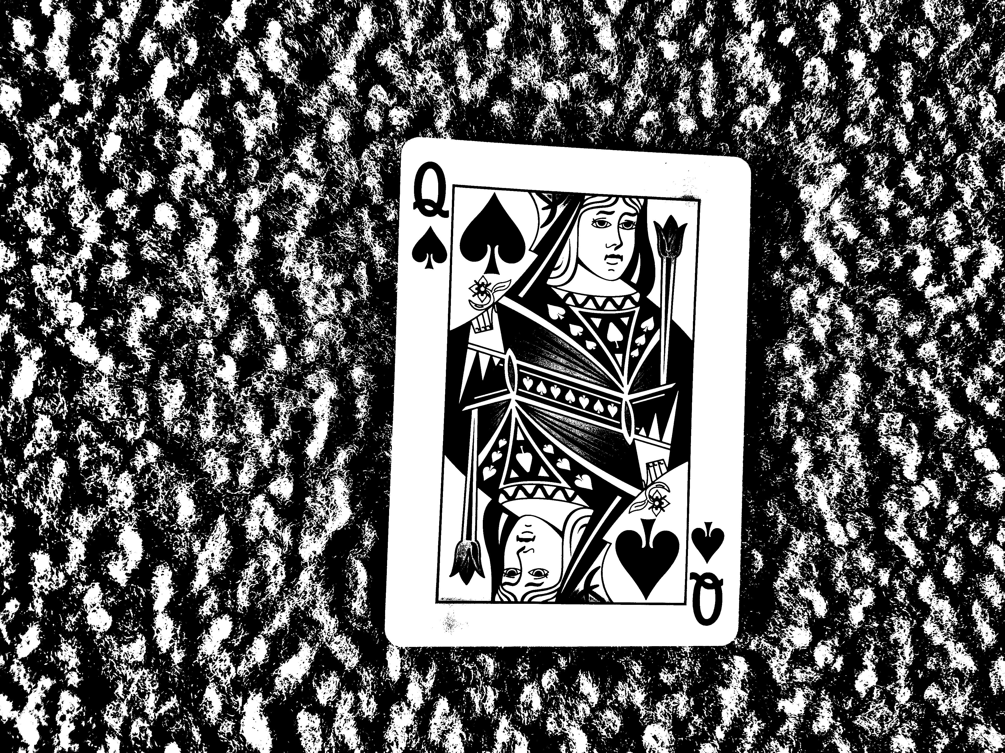
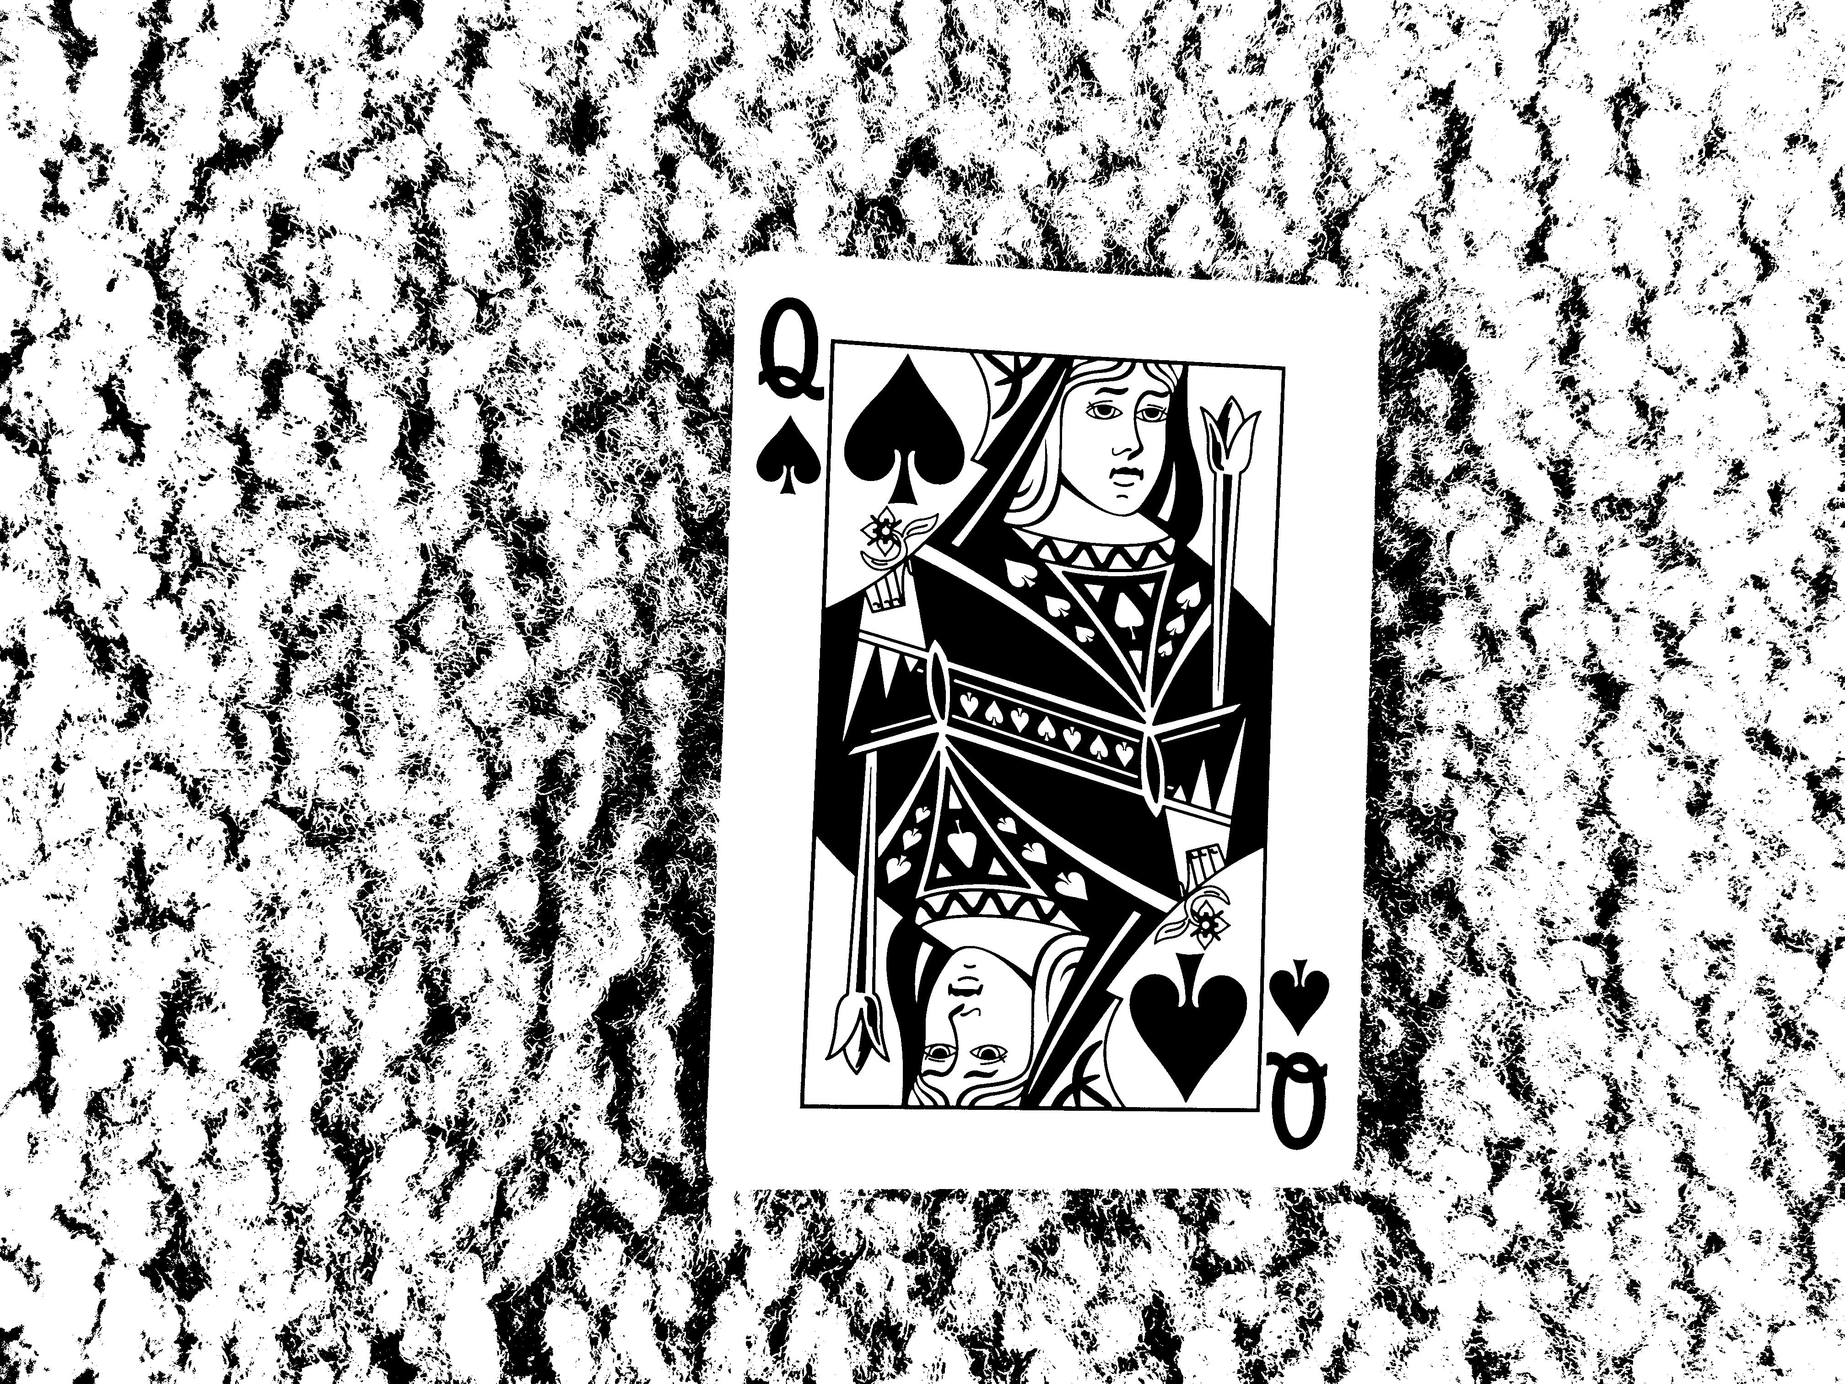
Challenges and initial
Initial Challenge : Background Removal
Bright, non-uniform backgrounds are not easy to remove.
Base Image
Adaptive Thresholding
Otsu’s Method

Slide 8
Methodology: What was done so far…

Slide 9
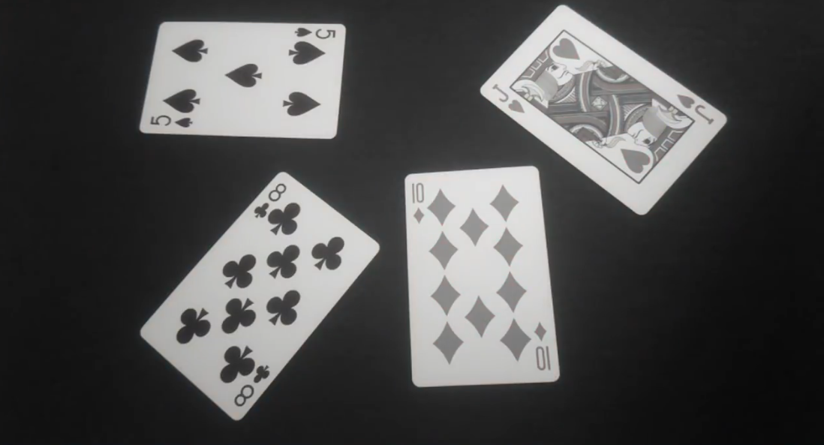
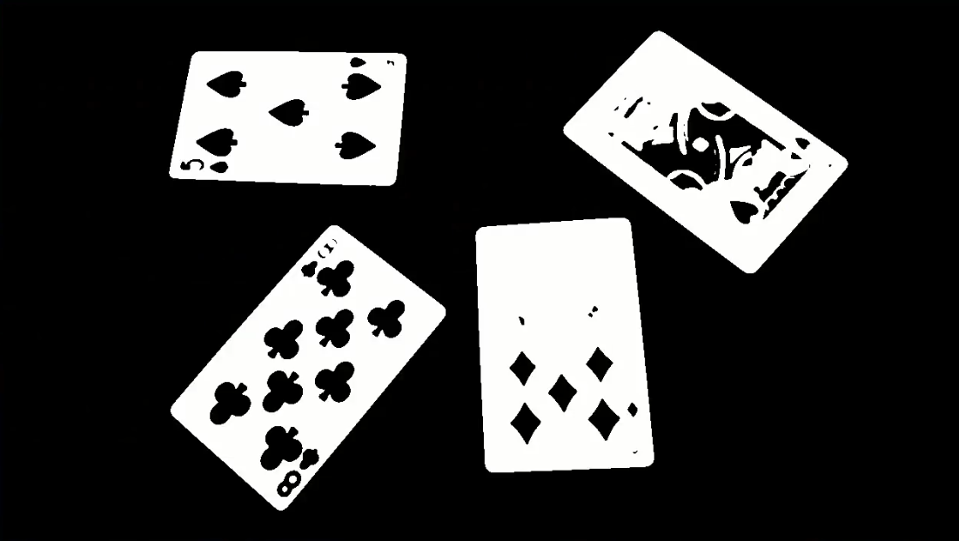

Preprocessing
Converted to Grayscale and blurred to get rid of noise.
Thresholding of the image to prepare it for finding contours

Slide 10
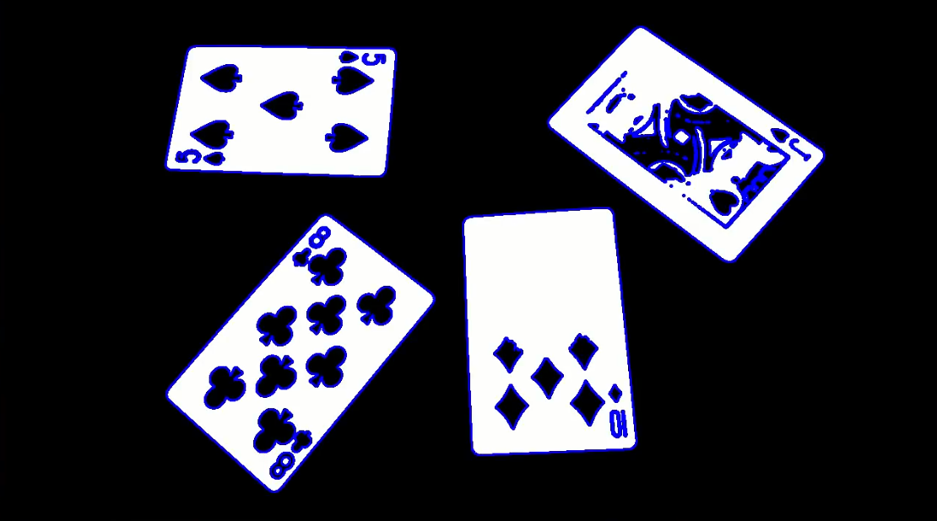
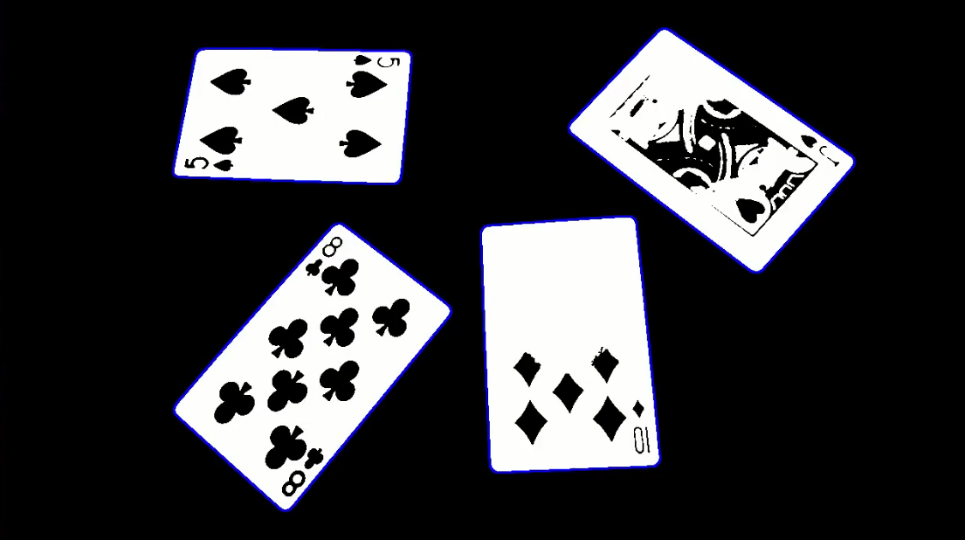
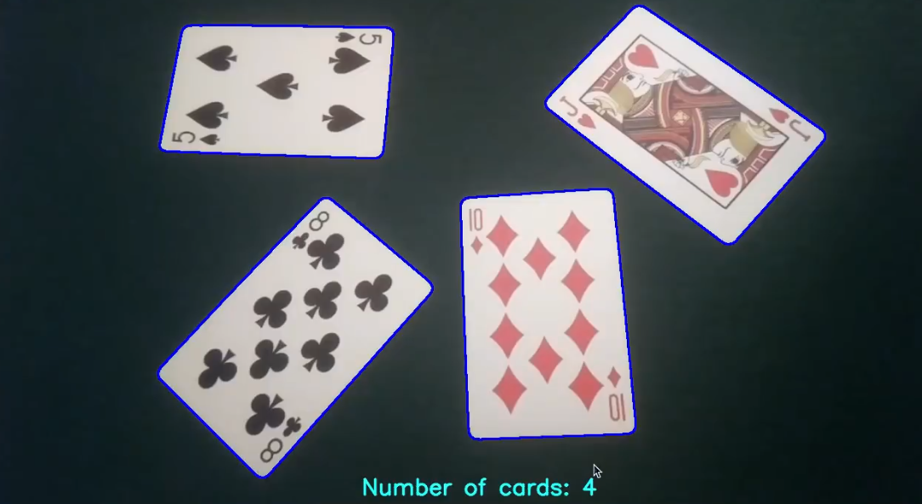
Contours
Finding the contours of the image.
Extracting playing card size contours.
Compute the number of playing cards.

Slide 11
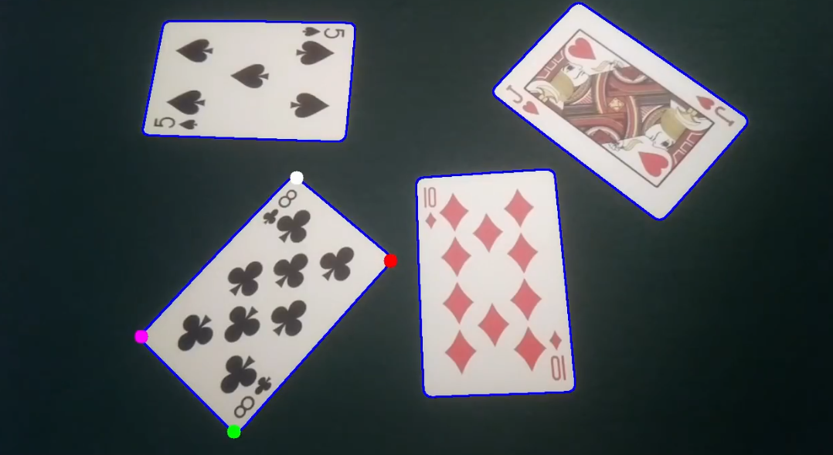
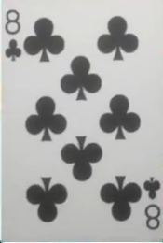
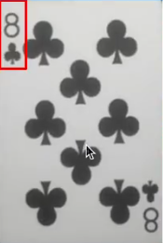
Transformation
Approximating the corner points of the contours.
Transform the card into 200x300 flattened perspective in order to implement template matching techniques.
8. Snip the corner of the image to isolate the Rank and Suit.

Slide 12
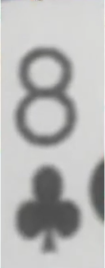

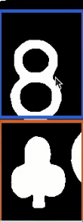
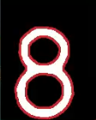
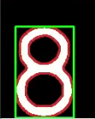

Isolating Rank and Suit
Corner is zoomed in by a factor of 4.
Isolated Rank and Suit is thresholded.
Separate Top and Bottom half.
Isolating Rank and find contours.
Rank is snipped out using the minimum area bounding rectangle.
Snipped out image is resized into 70x125 pixels.

Slide 13
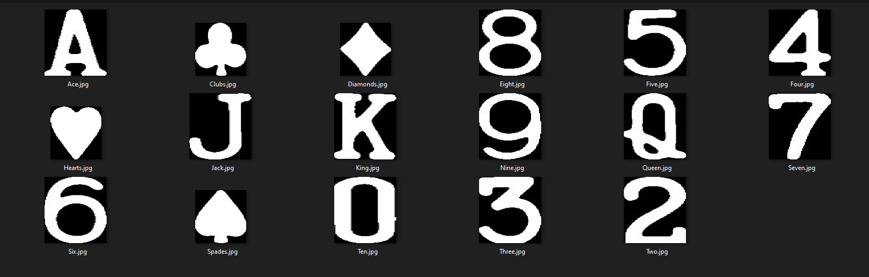
Comparing with the template image set.

Slide 14




Where the magic happens.
Isolated Rank image is compared with all the available template images.
Pixel wise image subtraction is performed with all the template images.
Count the number white pixels in the resulting image and assign scores when compared with every template image.
High number of white pixels ➔ Higher Score ➔ Poor match and vice versa.
Checked with every trained image ➔ Find template with lowest score(Best Match).

Slide 15
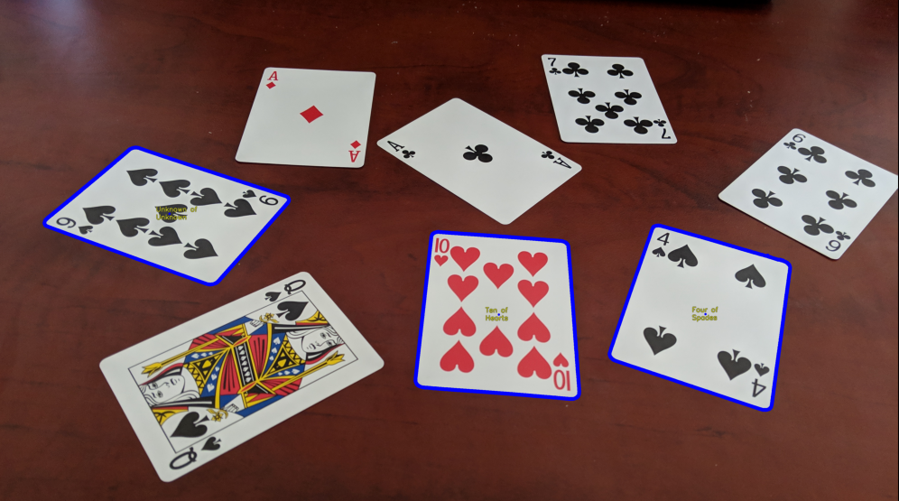
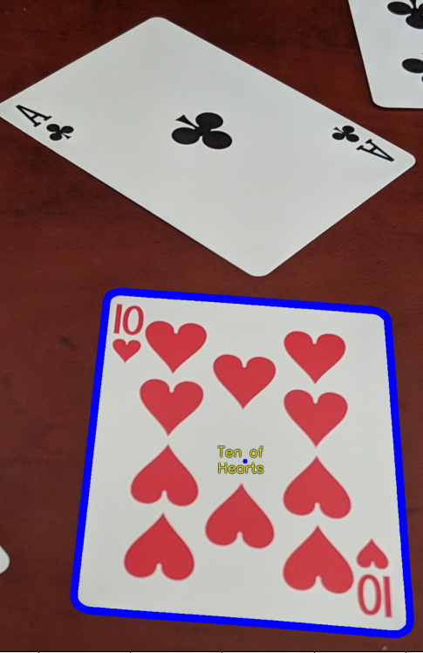
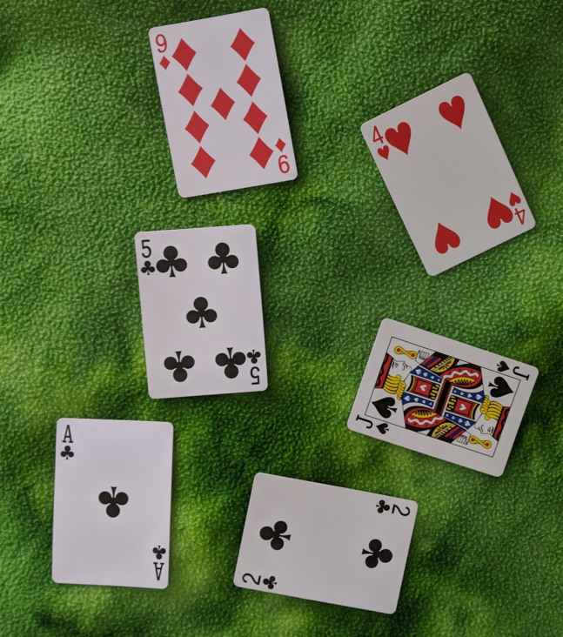
Edge cases, limitations and where to improve.
The proposed system had average accuracy when the images were taken in different angles and orientations.
System performed extremely poorly when photos had non-uniform backgrounds, failing to identify a single playing card.
Algorithm runs on every card on the image, checking against all the available template Ranks and suits. Therefore, can be considered as a an computationally expensive algorithm.

Slide 16
Thank you

